Slide 1
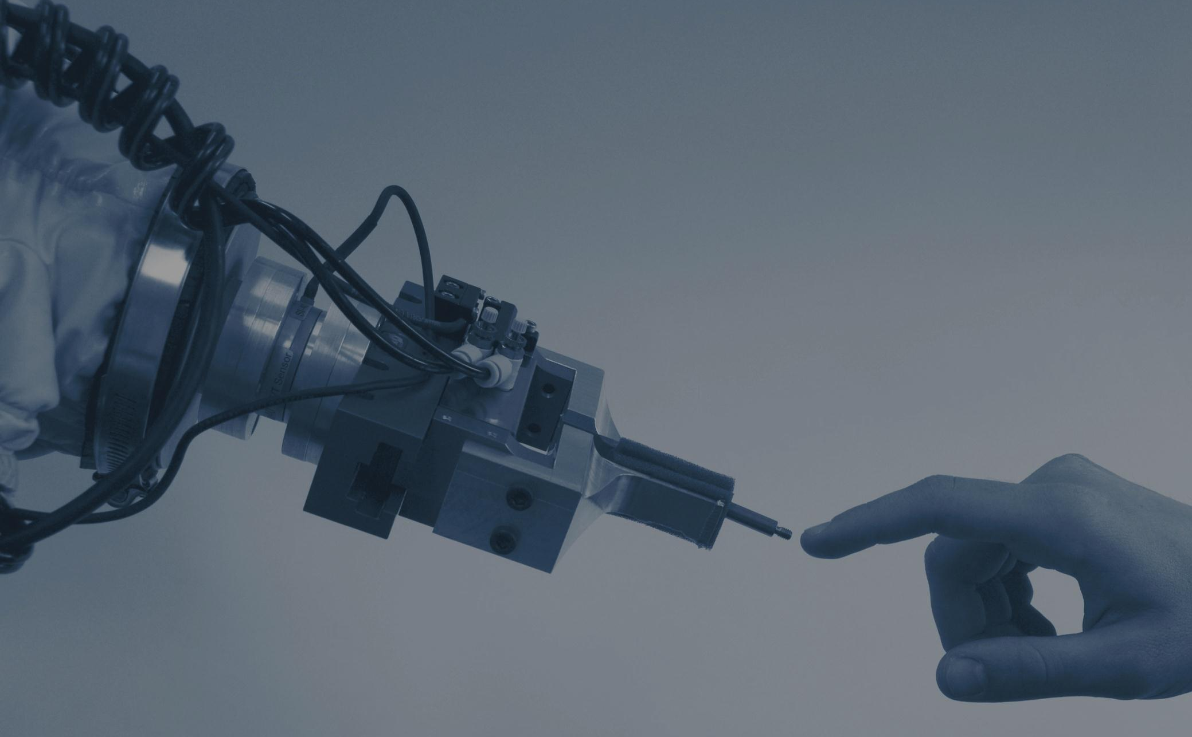
Upcoming scientific robotic trends and emerging applications Results of a literature survey
Christophe Simler, ECHORD project, TUM
simler@in.tum.de

Slide 2
Overview
Introduction
Autonomy and bio-inspiration
User interface, human robot interaction
Control and planning
Modular robotics and multi-agent systems
Advanced cognition
Safety and security
Tests and validation
Conclusion
2

Slide 3
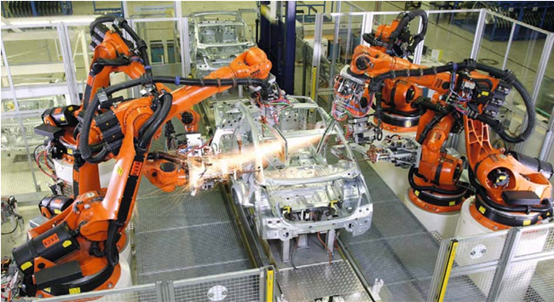
Introduction: traditional robotics and limitations
Industry – pre-programmed repetitive tasks in structured environment
Not flexible enough/ new or changing tasks
Not robust enough/ inaccuracies of scene geometry
extensive amount of
programming effort
[Craig 05]
3

Slide 4
Introduction: today´s challenges
Improve industrial robots by including more “cognitive” capabilities
Use robotics in many other fields to facilitate everyday life and specific missions or operations
Build robots having human skills [Weng et al. 09]
Autonomous systems - right level of autonomy - good HRI skill.
4

Slide 5
Introduction: generic scheme of an autonomous robotic system
User
User interface:
multimodal, interactive, visual
High level task
- Lack of robustness, reliability
and safety
- Tests are needed
Multimodal perception
(for autonomy, ERI and HRI)
Estimation, understanding
Environment, users
Multimodal feedback
Task planner
Internal models
Motion planning
Mechanics
Actuator
Controller
5

Slide 6
Introduction: trend extraction via bibliography analysis
Bibliography ranging from 2006 to 2012.
44 journals:
Artificial life and Robotics
Frontiers in Neurorobotics
IEEE Robotics & Automation Magazine (M-RA)
IEEE Transactions on Robotics (T-RO)
IEEE Transactions on Automatic Control
International Journal of Medical Robotics and Computer Assisted Surgery
International Journal of Robotics Research
International Journal of Advanced Robotics Research
Journal of Automation, Mobile Robotics & Intelligent Systems (JAMRIS)
Journal of Field Robotics
Journal of Robotics
Robotics and Autonomous systems
Sensors and Actuators A: Physical
6

Slide 7
Introduction: trend extraction via bibliography analysis
Robotics and Computer-Integrated Manufacturing
The Journal of Urology
Automatica
Mechanism and Machine Theory
Control Engineering Practice
Pattern Recognition
Pattern Recognition letters
European Urology Supplements
Urology
Computer-Aided Design
Computers in Industry
Mechatronics
Neurocomputing
Acta Astronautica
Gynecologic Oncology
7

Slide 8
Introduction: trend extraction via bibliography analysis
Image and Vision Computing
Journal of Manufacturing Systems
Expert Systems with Applications
Metal Finishing
Journal of Biomechanics
The Annals of Thoracic Surgery
Neural Networks
Mathematics and Computers in Simulation
Artificial Intelligence
Artificial Intelligence in Medicine
Computer Vision and Image Understanding
Computers and Electronics in Agriculture
Journal of Molecular Biology
Applied Ergonomics
Engineering Applications of Artificial Intelligence
Futures
8

Slide 9
Introduction: trend extraction via bibliography analysis
Intelligent Service Robotics
Medical Robotics
Rehabilitation Robotics
Automation in Construction
Human Movement Science
Phys Med Rehabil Clin N Am
Contemporary robotics – challenges and Solutions
Knowledge-Based Systems
Computers in Human Behavior
New Ideas in Psychology
9

Slide 10
Autonomy and bio-inspiration
Autonomy:
In a few years: semi-autonomous systems improved and extended to many fields for large scale applications (prototypes)
Different functions: assistant, rehabilitation and social robots
Optimal level of autonomy will be determined for each field
Interaction with “intelligent spaces” and home controllers
Later: fully autonomous systems and cognitive teams. Human-like robots
Applications involving humans and safety are particularly difficult: surgery, search and rescue, service robotics -> delay in autonomy with respect to other fields.
[Braun et al. 08, Broekens et al. 09, Allin et al. 10, Oetomo et al. 10, Henten et al. 11, Heyer 10, Ellery 08, Birk 11, Hashimoto 07]
10

Slide 11
Autonomy and bio-inspiration
Bio-inspiration:
Algorithms: based on advanced neural models from neuroscience analyses, adaptive robot behaviors
Mechanical designs, actuators and sensors: humanoids, robot hands, insect multi-legs, soft-compliant actuation systems using pneumatics or artificial muscles, multimodal perception, tactile skin
[Brice et al. 10, Parisi 10, Roy et al. 11, Prattichizzo et al. 12, Ljspeert 08, Buchli et al. 11, Dominey et al. 09, Yousef et al. 11, Kim et al. 09, Cortes et al. 07, Kumar et al. 08, Yen et al. 09, Seo et al. 07]
11

Slide 12
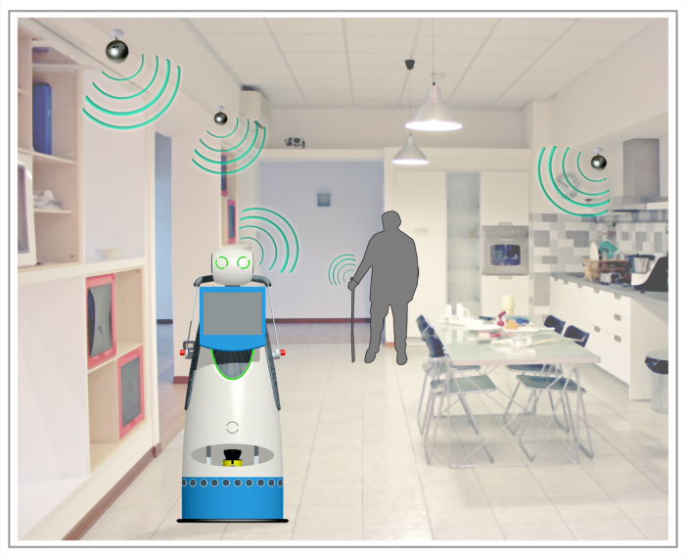
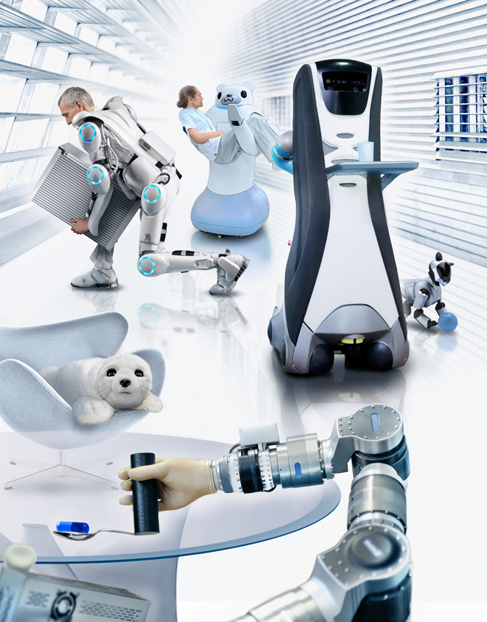
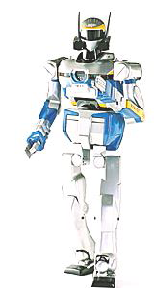
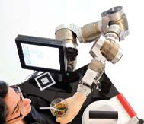
Autonomy and bio-inspiration
12

Slide 13
User interface, human robot interaction: global overview
Adaptive: situation understanding, personalized behavior – observation, learning user features [Cortes et al. 07, Kumar et al. 08, Yen et al. 09, Su et al. 11]
Easy-to-use, natural, intuitive, interactive, human-like and friendly: multimodal perception and feedback [Brice et al. 10]
Typical application fields: medical/health care and domestic service
Tactile feedback [Prewett et al. 10], virtual/augmented reality [Cortes et al. 07, Zollo et al. 11, Suh et al. 11, Wall 08]
Typical application fields: surgery, therapy, manipulation, medical,
hazardous field
Higher level of abstraction (task level), decomposition into subtasks
13

Slide 14
User interface, human robot interaction: sensor and algorithms
Vision and 3D geometrical sensors:
Human recognition: persons, actions, situations [Bien 07, Hoilund 12]
Scene processing: better situation understanding [Hartley et al. 00, Thrun et al. 05, Bishop 07]
Temporal, 3D and contextual information [Maniadakis et al. 11]
Reliable patterns – occlusion and invariance [Liu et al. 12]
Probabilistic kernel classifiers (RVMs) [Bishop 07]
Probabilistic SLAM with severely underdetermined data set, outdoor SLAM [Chen et al. 11, Adams 07]
Efficient and accurate knowledge representation of the environment [Lavalle 06]
Semantic level of information
14

Slide 15
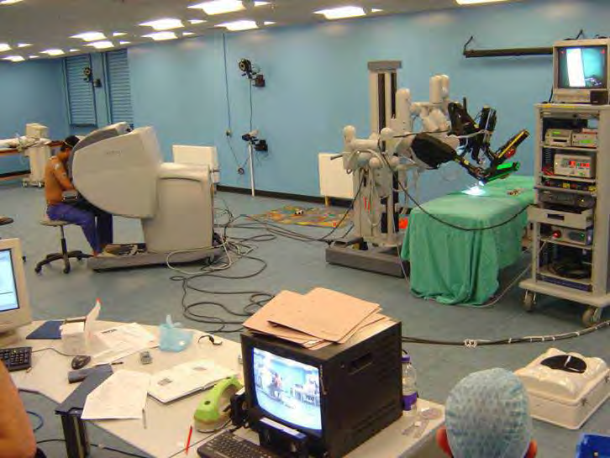
User interface, human robot interaction: sensor and algorithms
Force/tactile sensors:
Guiding, body extenders, coded touch instruction transmission, teaching by touching, exchange objects, dance or transportation with robots, touch therapy, surgery, manipulation, grasping, exploration [Argall et al. 10, Marcheschi et al. 11, Zollo et al. 11, Drumwright et al. 07, Broekens et al. 09]
Integration – end effectors – humanoid legs - robot hand fingers
Force feedback visualized in surgery [Braun et al. 08]
15

Slide 16
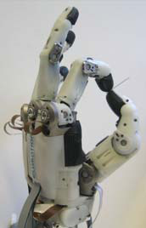
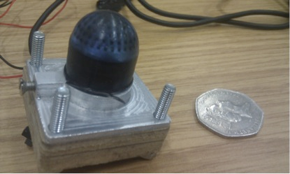
User interface, human robot interaction: sensor and algorithms
Force feedback for reliable force control (grasping, manipulation, leg locomotion and stability) [Yousef et al. 11, Rodic et al. 09, Tegin et al. 05]
Improved to enable complex grasping and manipulation with robot hands. Soft artificial skins with highly distributed tactile sensors [Yousef et al. 11]
Suitable processing techniques of their data and extraction of dynamic information
16

Slide 17
User interface, human robot interaction: sensor and algorithms
Audio sensors, robot language and emotion:
Improvement of speech recognition algorithms
Add language ability using sophisticated brain models [Parisi 10]
Integration of voice tone, emotion and motivation [Parisi 10]
Knowledge transfer between robotics and neuroscience
Typical application fields: service and rehabilitation robotics.
Physiological signals:
Control the physical HRI during robotic therapy administration of stroke patients [Zollo et al. 11, Badesa et al. 12]
Health status monitoring in smart home [Seo et al. 07]
17

Slide 18
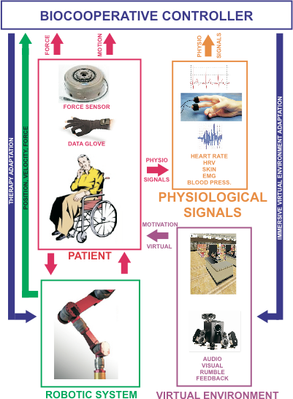
User interface, human robot interaction: sensor and algorithms
18

Slide 19
User interface, human robot interaction: sensor and algorithms
Brain machine interfaces:
Help paralyzed people to perform daily tasks with a robotic arm [Kennel et al. 12]
Adaptation of manipulator´s technology [Kennel et al. 12]
Improvement of brain signal extraction, processing and connection to the robot [Kennel et al. 12, Kim et al. 09]
Tactile feedbacks for efficient manipulation [Kim et al. 09]
Impedance control and decoding from the brain of the intended mechanical impedance [Kim et al. 09]
Decoding high level tasks from the brain, more autonomous robotic systems, finding the optimal level of autonomy [Kim et al. 09]
19

Slide 20
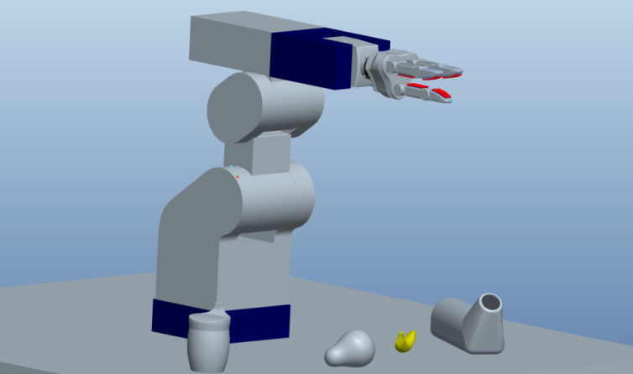
User interface, human robot interaction: sensor and algorithms
Development environment:
Easy integration of commercial industrial automation and new perception technologies will be provided by the extension of ROS (robot operating system)
Simulation environment:
Medical/health care, surgery and in domestic/personal service. Handicapped patients using BMI to control a robot will use simulations to select or reject a planned task [Braun et al. 08, Kennel et al. 12]
Sensor fusion
20

Slide 21
Control and planning
Control:
Bio-inspired controllers – neural models – adaptive learning [Roy et al. 10]
Automatic grasping of unknown objects [Richsfeld et al. 09]
Approach human-like manipulation. Progress of tactile sensors integrated into robot hands [Yousef et al. 11, Kim et al. 09]
Underactuation of robot hands [Prattichizzo et al. 12]
Locomotion strategies using recent CPGs models and complex neural mechanisms. Knowledge transfer with neuroscience. Reliable controller for legged robotic locomotion [Ljspeert 08, Buchli et al. 11]
Adaptive impedance control on end effectors, legs and fingers of robot hands [Rodic et al. 09]
‘‘Soft actuation” systems. Better artificial muscle control [Kim et al. 09]
21

Slide 22
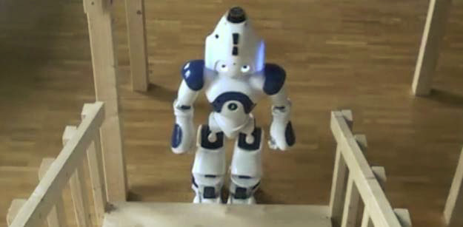
Control and planning
Automatic path/motion planning:
Optimal paths with geometrical and differential constraints [Lavalle 06]
Efficient motion planning with uncertainty in perception. Better information space representations. Dynamic environments [Thrun et al. 05, Roy et al. 11, Drumwright et al. 07]
Semantic information for path planning
Planning toward non-stationary goals
Humanoids: [Drumwright et al. 07]
Reaching and SLAM with moving obstacles
Locomotion and planning under uncertainty
Better tradeoff between exploration and exploitation
22

Slide 23
Modular robotics and multi-agent systems
Autonomous robot teams – self operations on team members [Bekey 07]
Self-organizing teams – learning new behaviors – self-coordinated – propagating information [Siciliano 08]
High-secured wireless network – share knowledge – decentralize components – remote control
Efficient, collision-free and fault-tolerant traffic control strategies applied on AGV systems in automatic warehouses [Olmi et al. 11]
Teams of robot tractors using sensor networks [Oetomo et al. 10]
23

Slide 24
Advanced cognition
Using behavioral systems – dynamic changes [Lee et al. 07, Siciliano et al. 08]
Easy robot behavior teaching with interactions, even for ordinary people
Improvement of reinforcement learning and programming by demonstration techniques [Siciliano et al. 08, Argall et al. 08, Thomaz et al. 08, Khamassi et al. 11, Bien et al. 07]
Deeper exploitation of the temporal dimension of sensory information [Maniadakis et al. 11]
Language – voice tone, emotion – knowledge transfer [Parisi, 10]
In addition to cognition, use of internal robotics [Parisi, 10, Ziemke 07]
24

Slide 25
Safety and security
Safety measures adapted to human robot collaboration
Intensive use of sensors to ensure human safety
Reliable human risk estimators and safety action models
Use of tactile sensors for collision detection [Argall et al. 10]
Methods recovering from collisions, consideration of temporal persistent physical interactions [Argall et al. 10]
Robustness against attacks from the network [Denning 09]
Safety and dependability metrics to successfully introduce robots in everyday environments [Denning 09]
25

Slide 26
Tests and validation
Large-scale completion and standardization of tests for robotic systems [Prewett et al. 10, Braun et al. 08, Gill et all. 11, Broekens et al. 09]
Formal methods of verification and synthesis of autonomous systems
Approximate verifications with reachable sets for dynamic hybrid systems [Kress-Gazit 11, Ding et al. 11]
Reach-avoid sets with environment sensing and obstacle avoidance
26

Slide 27
Conclusion
Human-like, interactive, easy-to-use, natural, abstraction, social, accessible
Situation understanding, learning and adaptation
Robust / uncertainty, dynamic scenes and changing goals
Use and communication skills?
Algorithm skills?
Safe and reliable bio-inspired autonomous and intelligent robotic systems. Cognitive robot teams.
Emotion, language, temporal cognition, internal robotics
Action?
Place?
Human intelligence, consciousness, thinking and independence
Performing human-scale tasks - collaborating with humans, physique and psychological help for a better life
In many sectors, difficult environments and in everyday life
27

